Slide 1



Airline On-Time Performance
View in Power BI
Last data refresh:
12/22/2020 12:07:30 PM Central Standard Time
Downloaded at:
12/22/2020 12:08:43 PM Central Standard Time

Slide 2
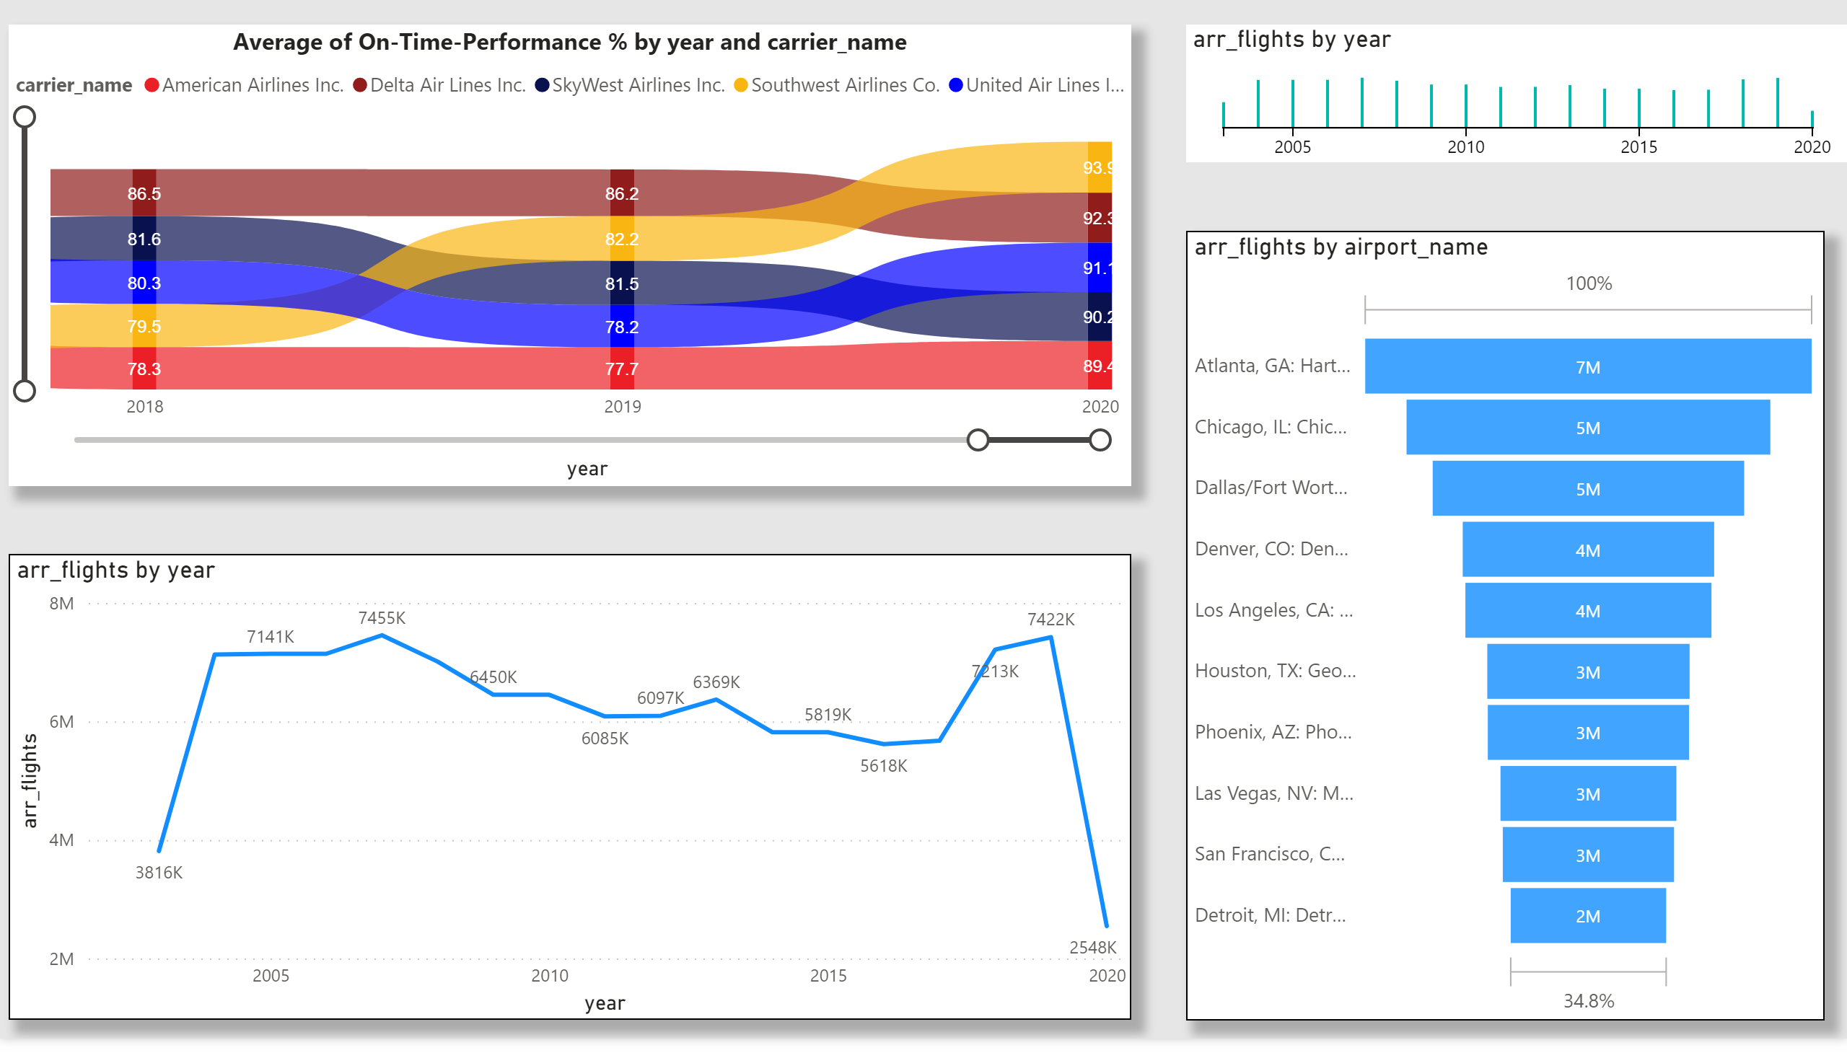

Slide 3
